Slide 1
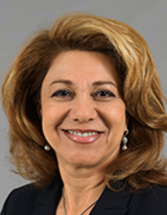
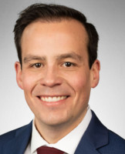
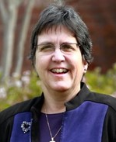
Infrastructure LA Sustainable Waste and Recycling Management
Impacts of COVID-19 on the implementation of SB 1383: Challenges and Potential Solutions
Shari Afshari
Deputy Director
LA County Public Works
Derek Dolfie
Legislative Representative
CA League of Cities
Lisa Rapp
Director of Public Works
City of Lakewood

Slide 2
Infrastructure LA
Thank you for joining today’s call!
For more information on Infrastructure LA and to sign up for email updates about future calls visit the website at: www.infrastructurela.org
Email: InfrastructureLA@pw.lacounty.gov

