Slide 1
Infrastructure LA
Sustainable Waste and Recycling Management
Thank you for joining us the meeting will start in a few moments
REMINDERS
Please mute your line during the call
There will be Q&A opportunities at the end of the presentations
Use the chat feature to ask questions and comments
You can also raise your hand during the Q&A and we will call on you to unmute and share
The meeting is scheduled for one and a half hours

Slide 2
Infrastructure LA
Sustainable Waste and Recycling Management
November Committee Meeting

Slide 3
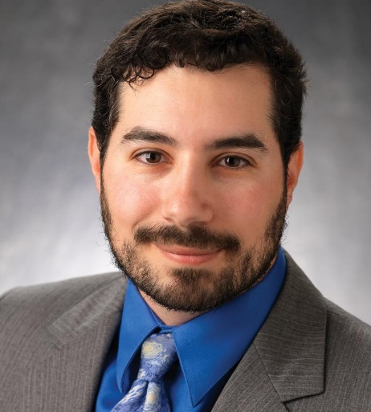
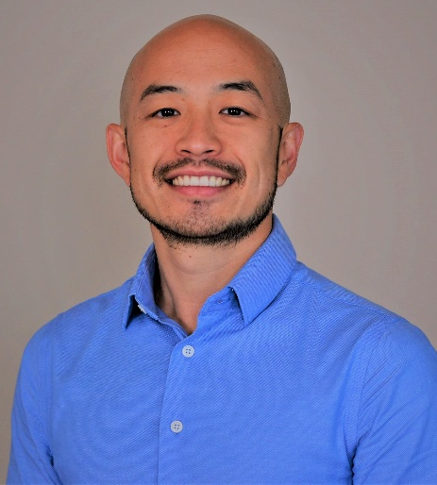
Infrastructure LA
Sustainable Waste and Recycling Management
  Coby Skye
  Assistant Deputy Director
  LA County Public Works
  CSkye@pw.lacounty.gov
  Will Chen
  Manager, Energy Recovery
  LA County Sanitation Districts
  WChen@lacsd.org

Slide 4
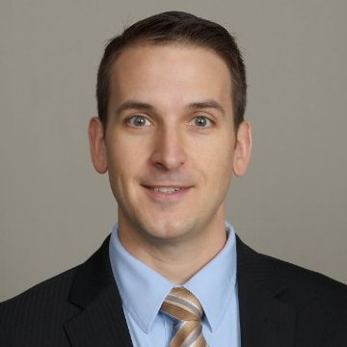
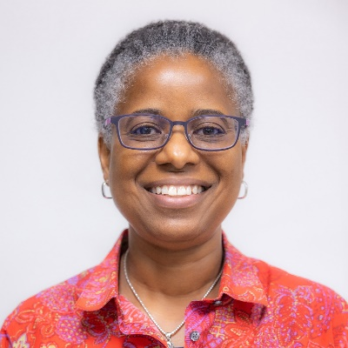
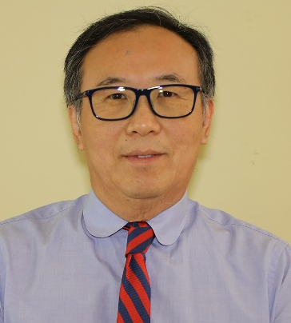
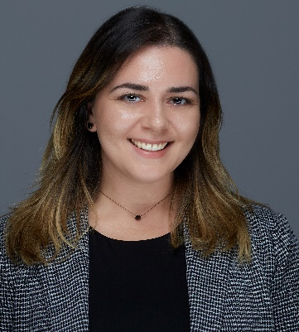
Infrastructure LA
Sustainable Waste and Recycling Management
  Household Hazardous and Electronic Waste
  Chris Sheppard
  Principal Engineer
  LA County Public Works
  CSheppard@pw.lacounty.gov
  Lisa Scales
  Project Engineer
  LA County Sanitation Districts
  LScales@lacsd.org
  John Park
  Senior Environmental Engineer
  LA City Sanitation
  John.Park@lacity.org
  Yasi Lozano
  Environmental Engineer
  LA City Sanitation
  Yasi.Lozano@lacity.org

Slide 5
Countywide Household Hazardous and Electronic Waste Management Program

Slide 6
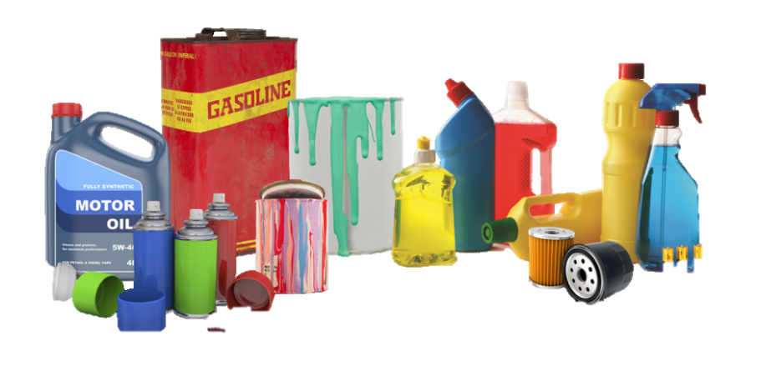
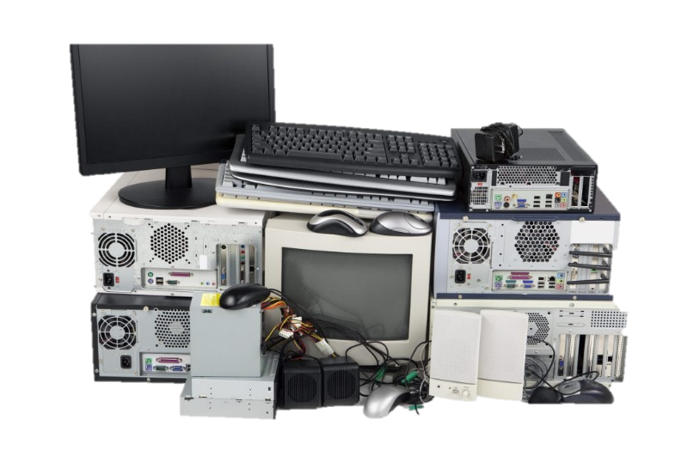
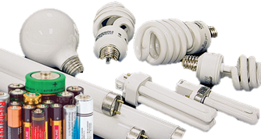
Countywide Household Hazardous and E-Waste Program - Overview
Today’s presentation will cover:
  History of the Program
  Structure and Services Provided
  Policies to Improve the Program
Household Hazardous Waste (HHW)
  Any product labeled toxic, poison, combustible, corrosive, flammable, dangerous or irritant
  Includes Electronic Waste and Universal Waste (Batteries, fluorescent bulbs, thermostats, etc.

Slide 7
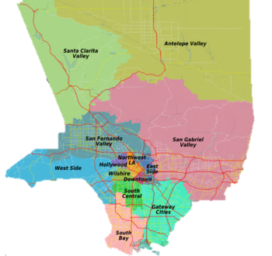

Partnerships
County Sanitation Districts (CSD): one-day temporary collection events
City of Los Angeles: S.A.F.E. Centers
Waste Management (WM) and Cities of Lancaster and Palmdale: AVECC
EDCO Transfer and Recycling Facility, CSD and the City of Long Beach: EDCO

Slide 8
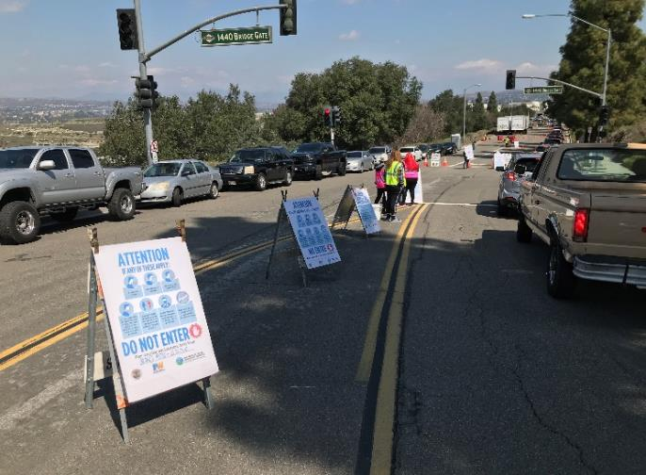
Primary Components of the Program
Temporary Events
  Hosted throughout LA County
Permanent Centers
  EDCO
  Antelope Valley Environmental Collection Center (AVECC)
  S.A.F.E. Centers
  Reuse Centers
Additional Programs
  Household Batteries
  Used Motor Oil
  Home-Generated Sharps Waste

Slide 9
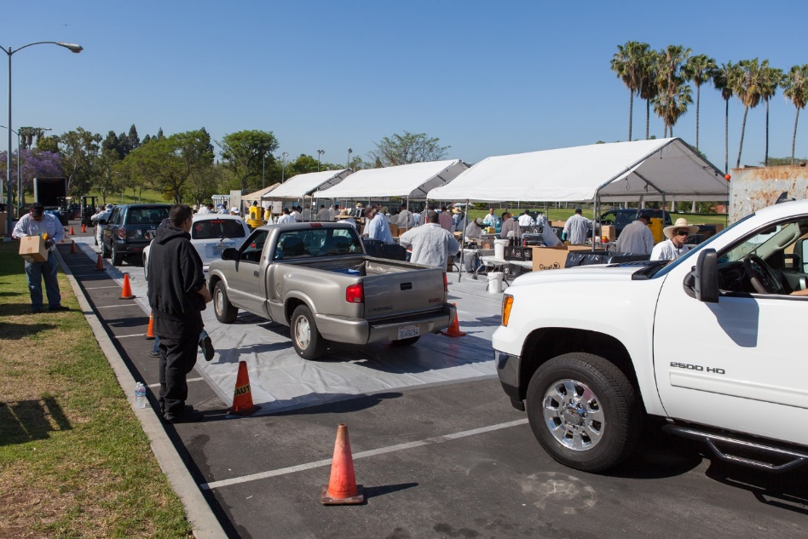
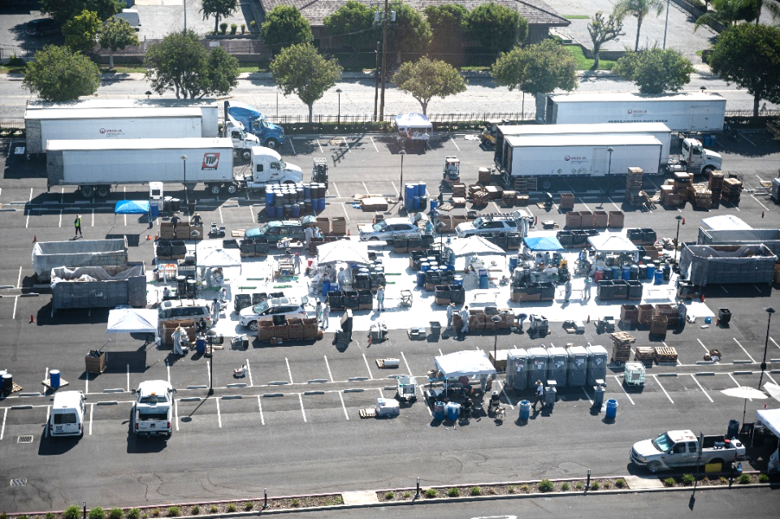
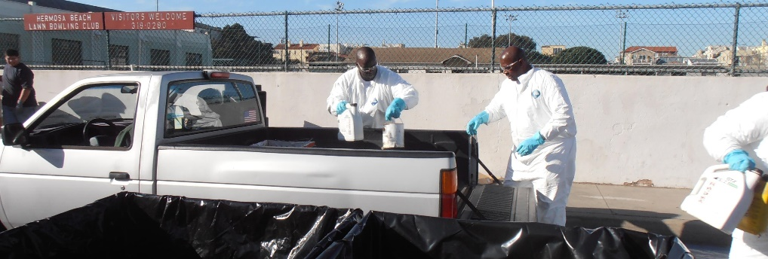
Temporary HHW/E-waste Collection Events

Slide 10
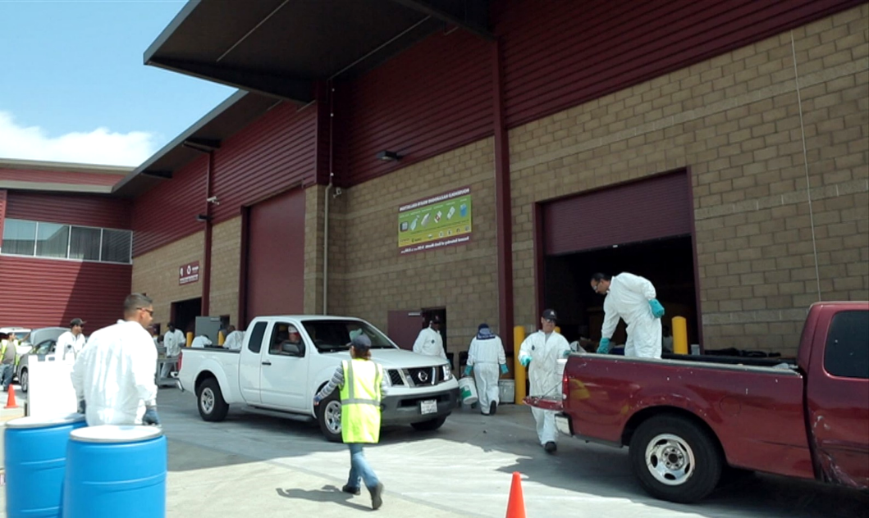
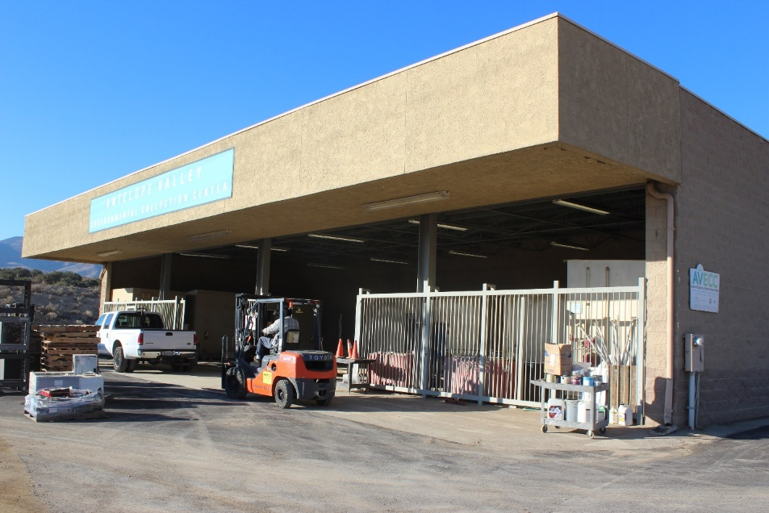
EDCO and AVECC Permanent Centers
EDCO
2755 California Ave.
Signal Hill, CA 90755
AVECC
1200 City Ranch Rd.
Palmdale, CA 93551

Slide 11
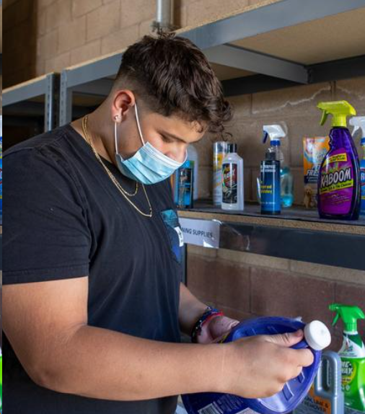
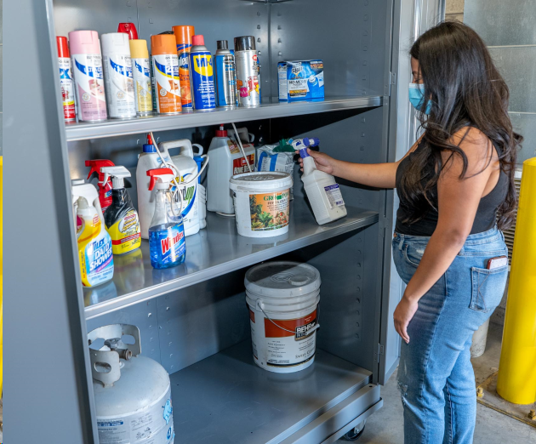
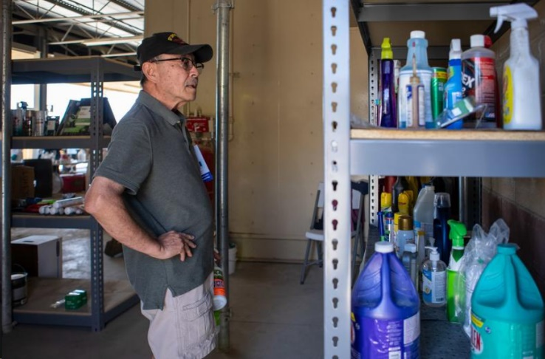
Reuse Centers

Slide 12
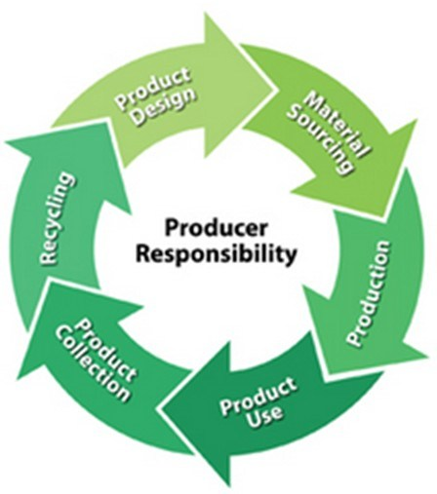
Benefits of Statewide Policies
Extended Producer Responsibility
Improves collection
Reduces improper disposal
Places greater responsibility, including costs on producers
Reduces program costs

Slide 13


1(888) CLEAN LA
CLEANLA.com
@CLEANLA

Slide 14
Infrastructure LA
Sustainable Waste and Recycling Management
  Household Hazardous and Electronic Waste
  Chris Sheppard
  Principal Engineer
  LA County Public Works
  CSheppard@pw.lacounty.gov
  Lisa Scales
  Project Engineer
  LA County Sanitation Districts
  LScales@lacsd.org
  John Park
  Senior Environmental Engineer
  LA City Sanitation
  John.Park@lacity.org
  Yasi Lozano
  Environmental Engineer
  LA City Sanitation
  Yasi.Lozano@lacity.org

Slide 15
HHW Collection Event Operations
SWARM Meeting
Lisa D. Scales
Project Engineer
November 9, 2023

Slide 16
HHW Collection Discussion Points
Benefits
Coordinating an Event
Operations
Quantities and Costs
Operational Challenges

Slide 17
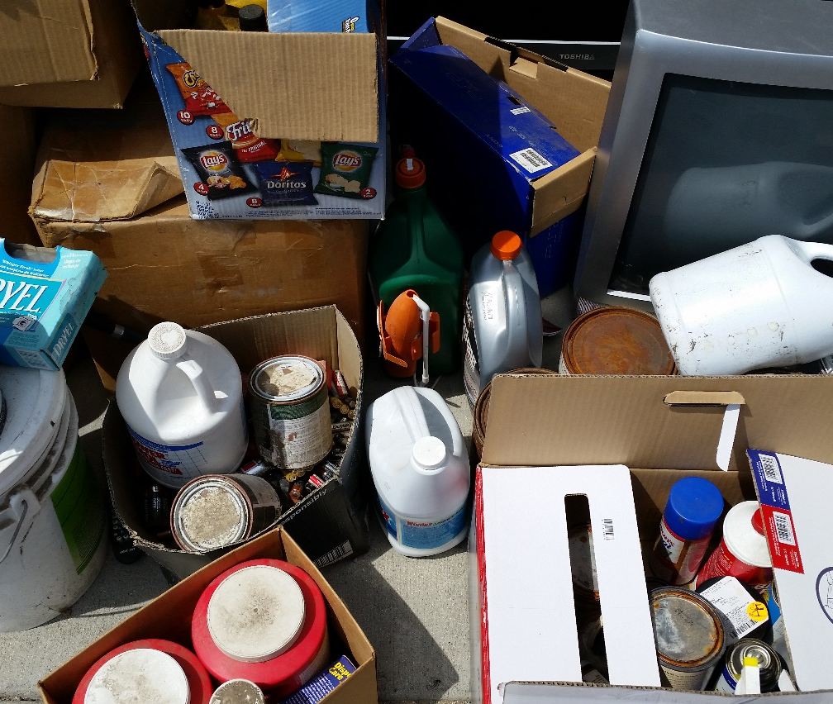
Why collect household hazardous waste?
Prevent pollution of ground water, air quality, and soil quality
Protect human health
Prevent physical injury to sanitation workers
Reduce illegal disposal in landfills, streets, storm drains, and sewers

Slide 18
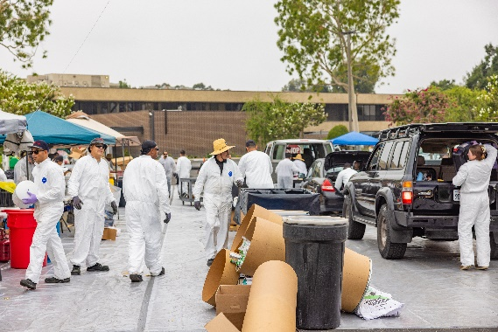
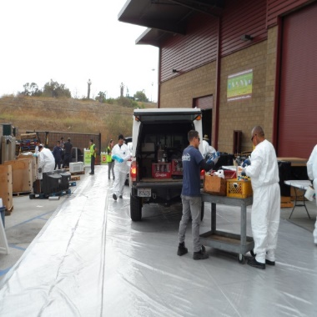
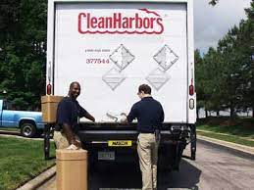
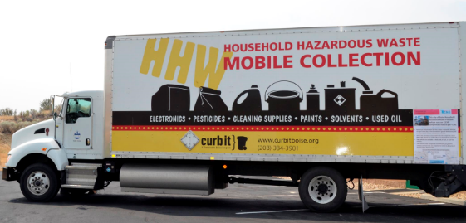
Types of HHW Collection Events
Temporary Round-up
Permanent Center
Door-to-Door Collection
Mobile Collection

Slide 19
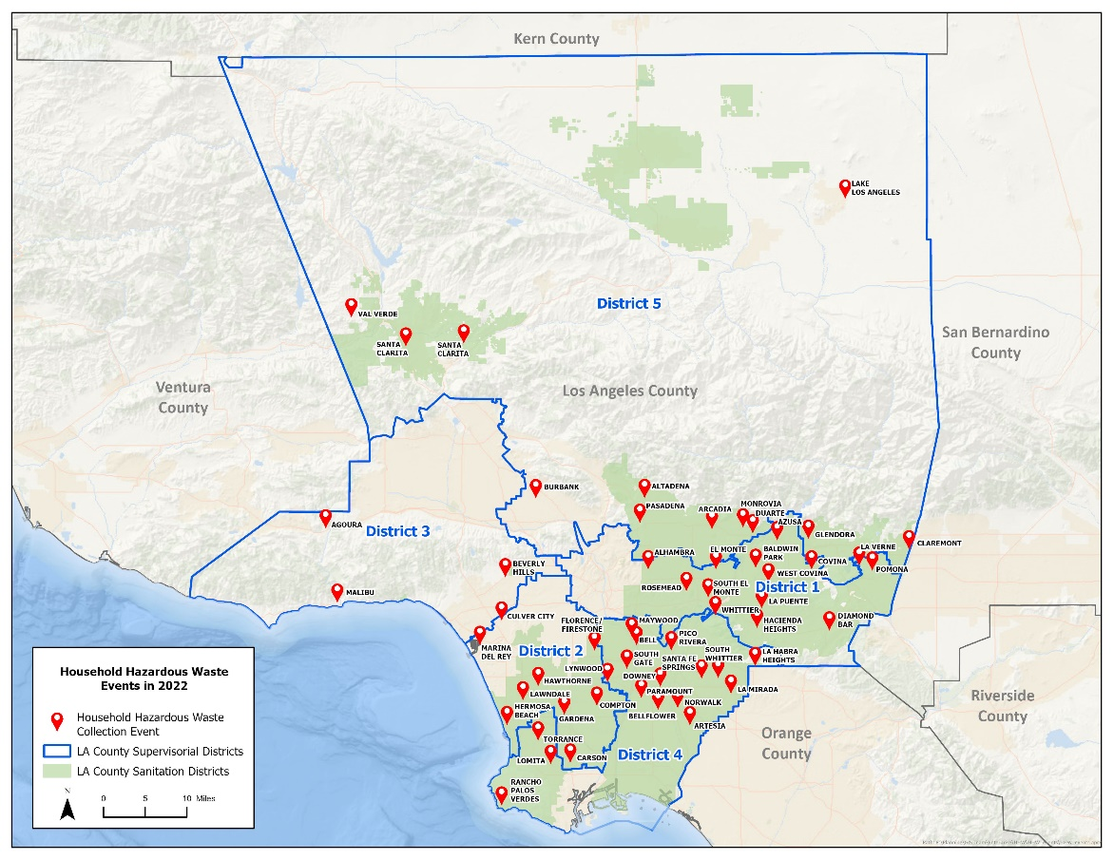
Temporary Event Collection Facilities
2022 TEMPORARY ROUND-UPS
57 Events
3.2 million pounds of HHW collected
42,217 households participated
$6.2 M*
* Includes collection, disposal, LACSD and public relations costs

Slide 20
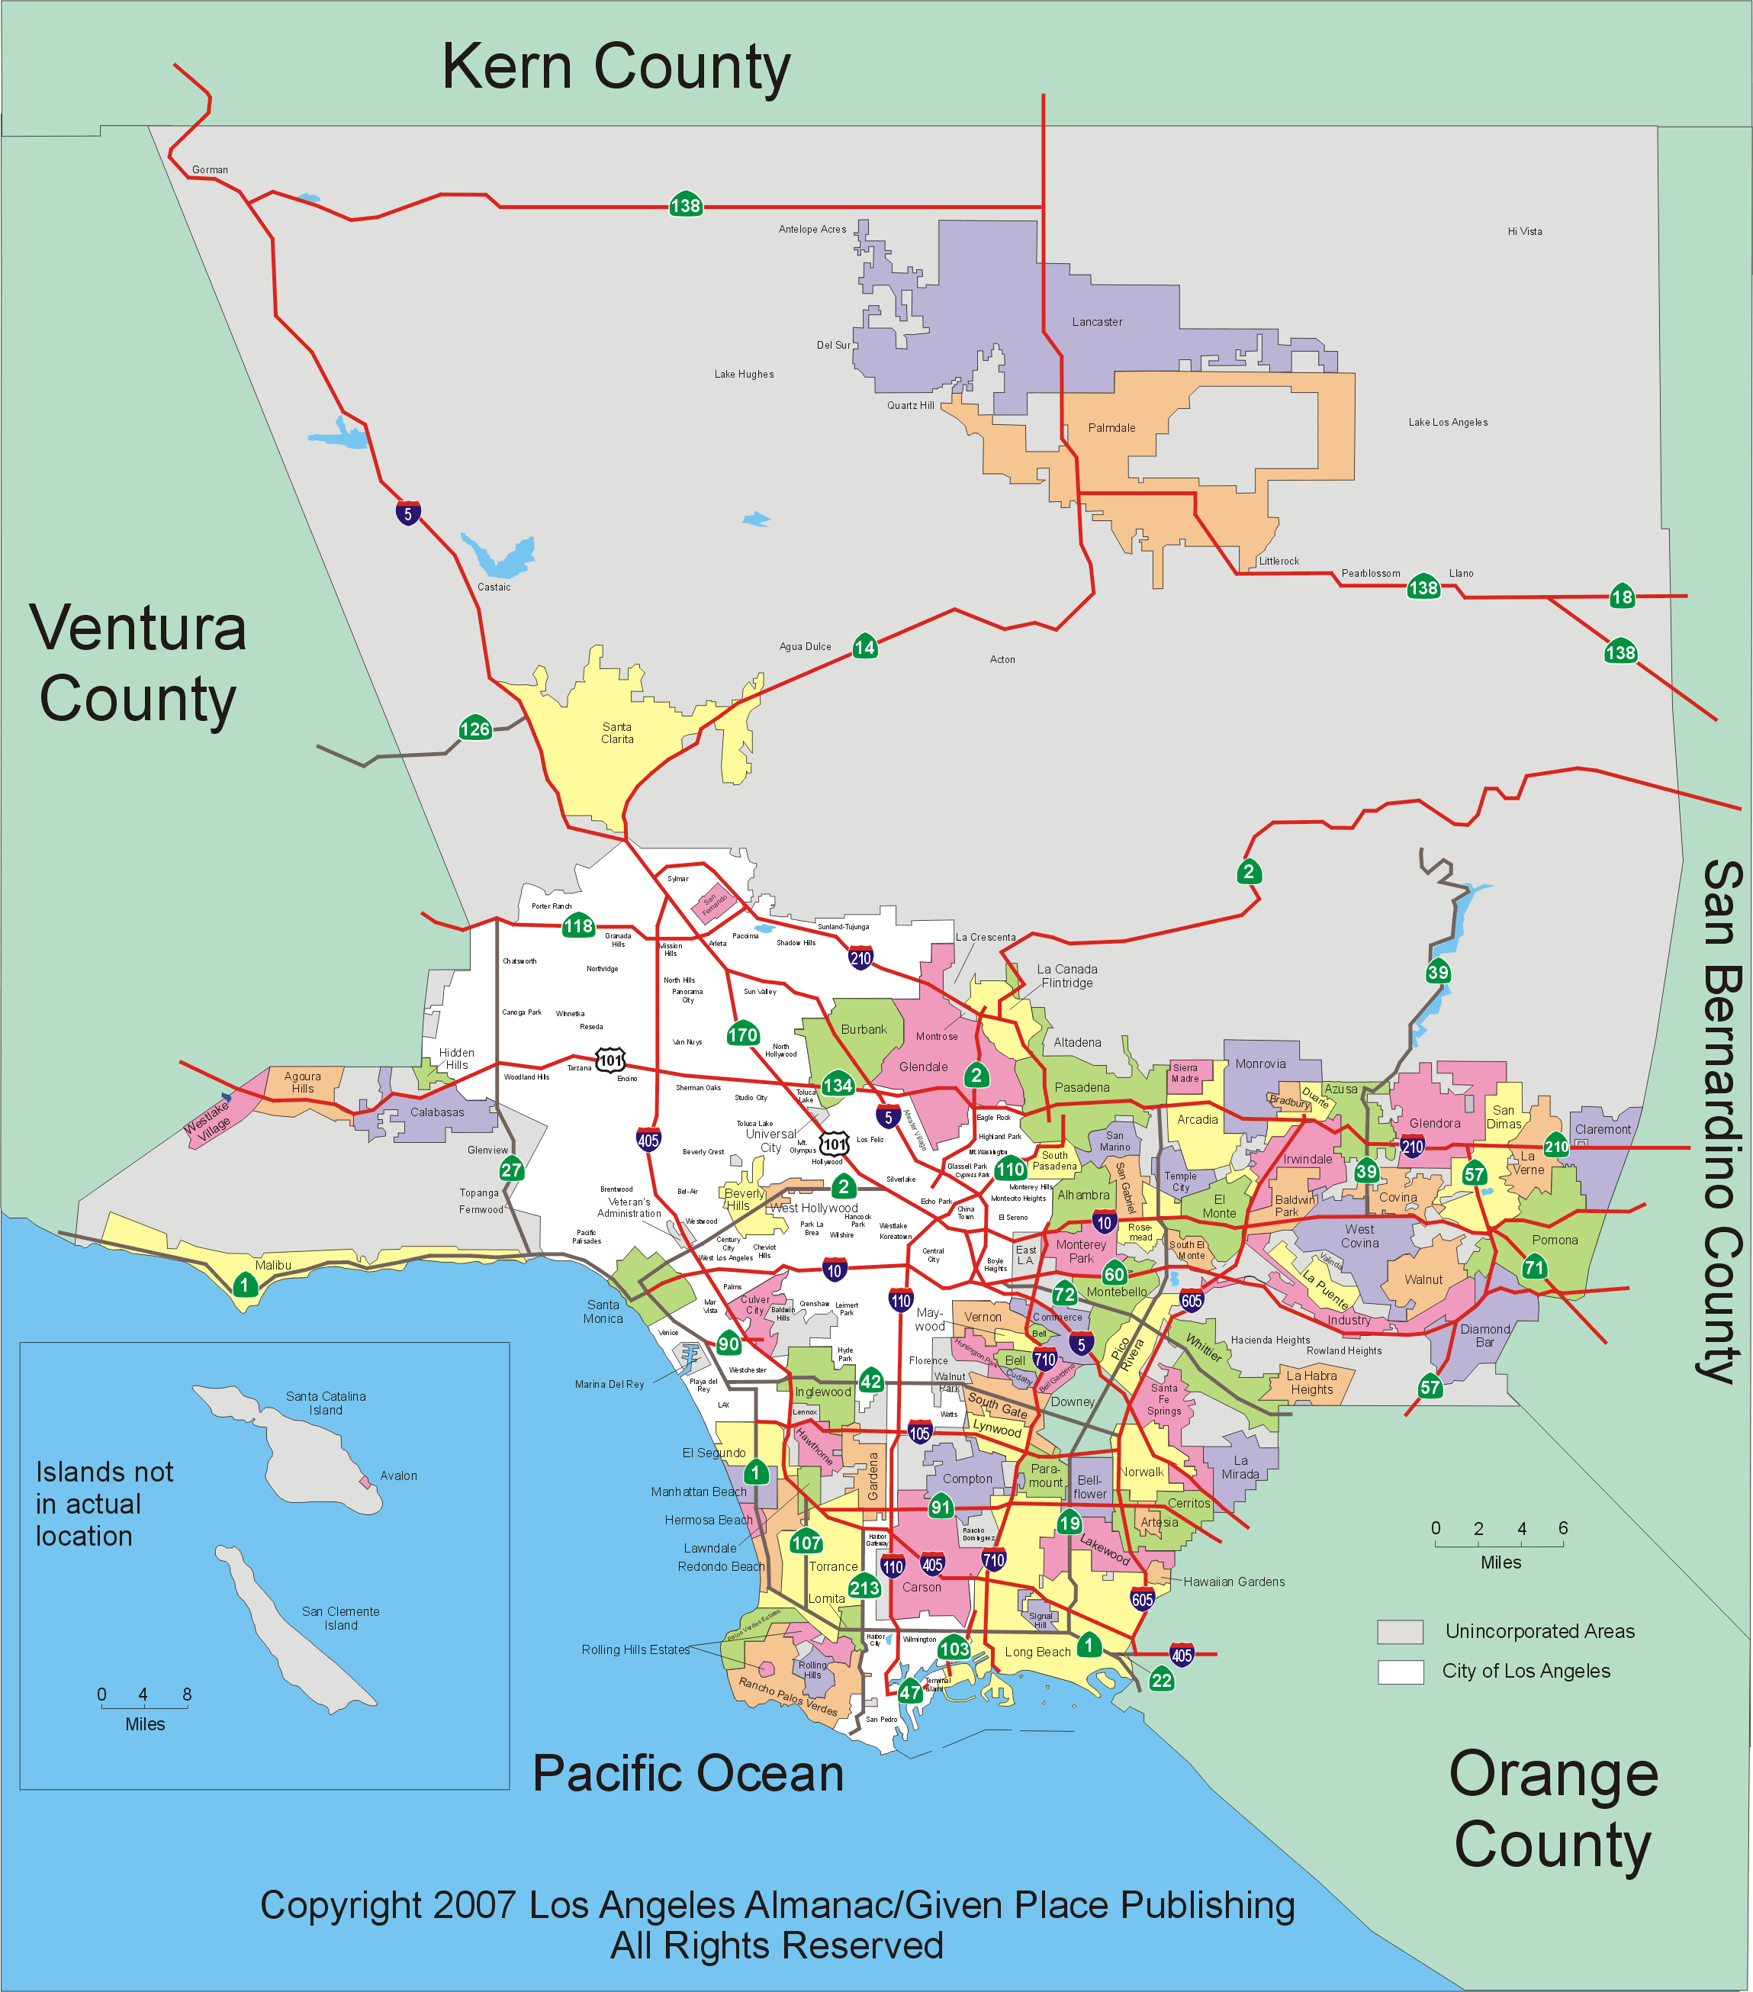
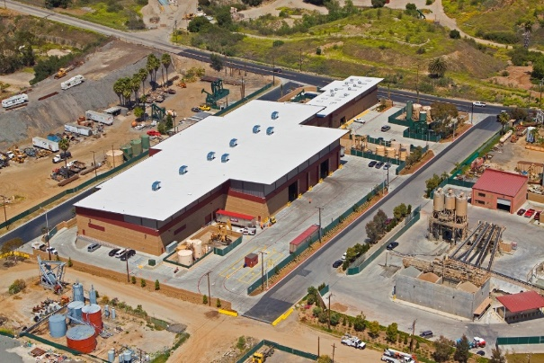




Permanent Centers
AVECC
City of LA SAFE Centers
2022 EDCO PERMANENT CENTER
21 Events
1.1 million pounds of HHW collected
13,560 households participated
$800K*
* Includes collection, disposal, and LACSD costs
EDCO ENVIRONMENTAL
COLLECTION CENTER
Signal Hill

Slide 21
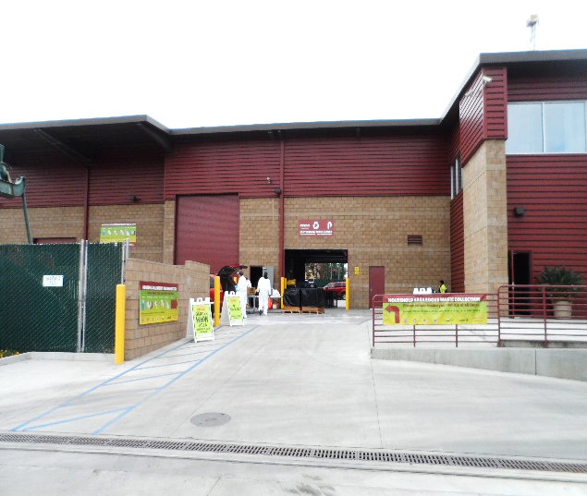
EDCO Permanent Center in Signal Hill
Collaboration with County PW, City of LB, EDCO Recycling & Transfer, the City of Signal Hill
Opened in March 2013; operates 2nd and 4th Saturday each month
Set-up like Temporary event
Small footprint; 250 households anticipated
600 households actual

Slide 22
Impossible without Teamwork
LACPW
Manage the Program
- Funding
- Education
- Reporting
LACSD
Manage the Events
- Scheduling
- Coordinating
- Oversee Operations
- Advertising
Cities &
Site Owners
Host the Events
- Auxiliary Staff
- Outreach
Contractors
Operate the Events
- Setup/Teardown
- Waste Disposal
- Form 303 Reporting

Slide 23
Steps to Operating an HHW Collection Event
* Location Scouting
* Scheduling
* Documentation
* Advertising
* Site Setup
* Safety Briefings
* Collection/Sorting
* Teardown
* Waste Removal
* Waste Summary
* CUPA Submittal
* Invoice Review
* Form 303
Pre-event
Event
Post-event

Slide 24
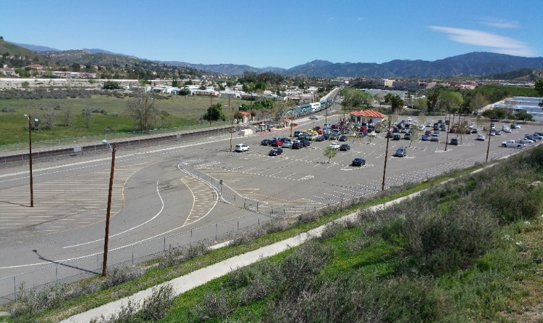
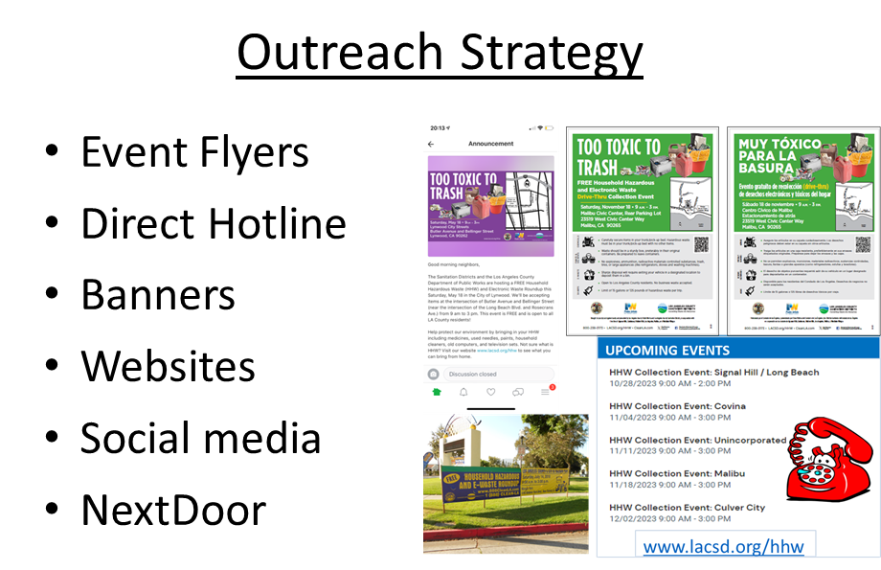

Pre-Event Activities

Slide 25
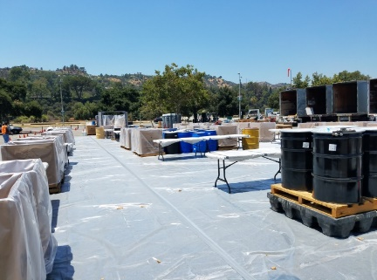
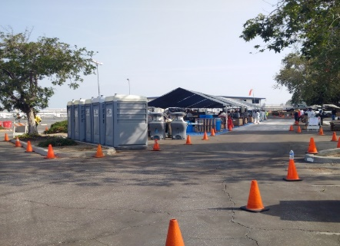
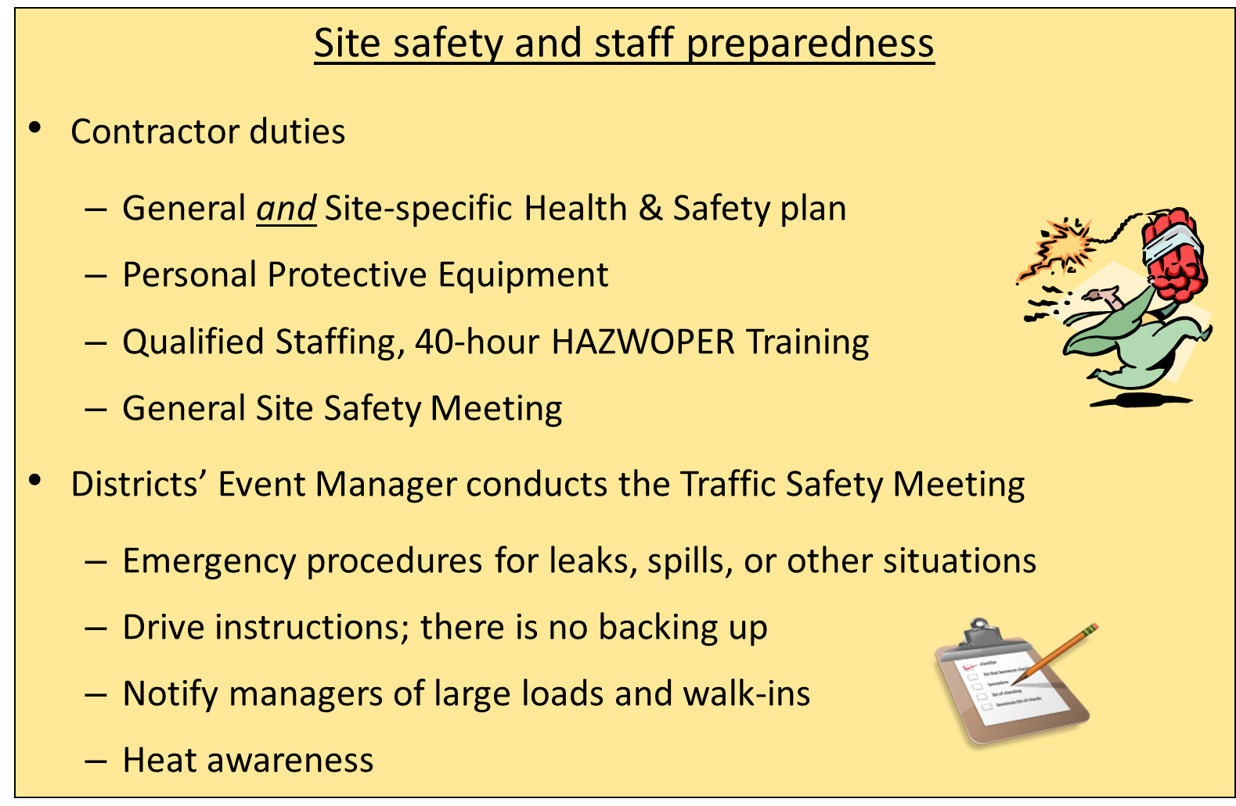
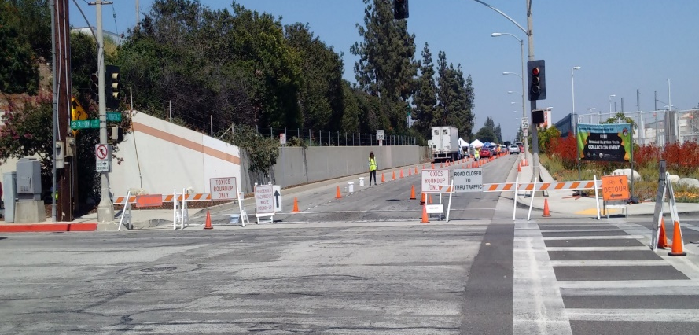
Site set-up includes various features.

Slide 26
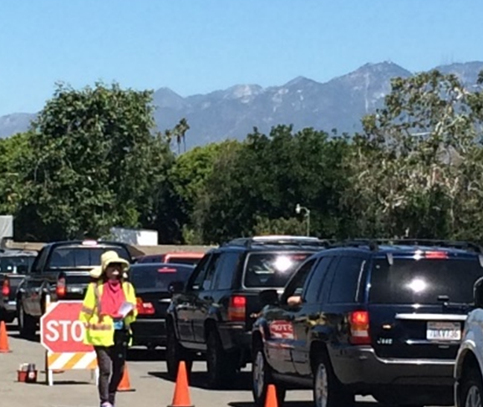
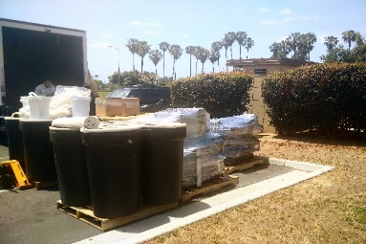
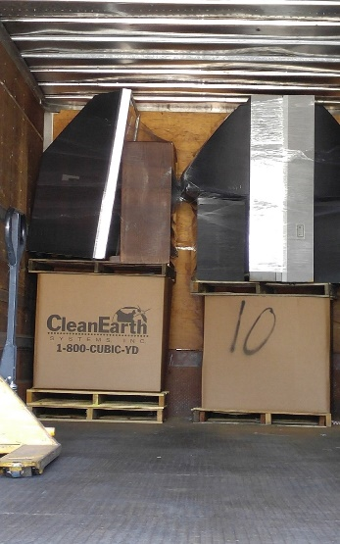
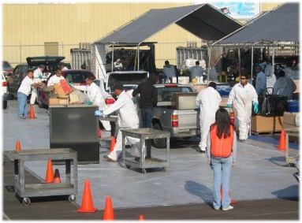
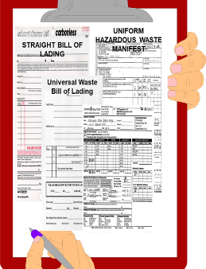
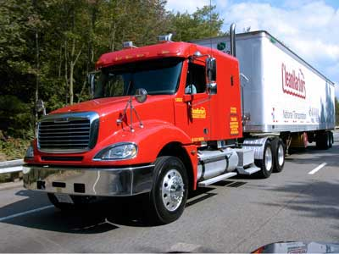
Waste Collection and Shipping

Slide 27
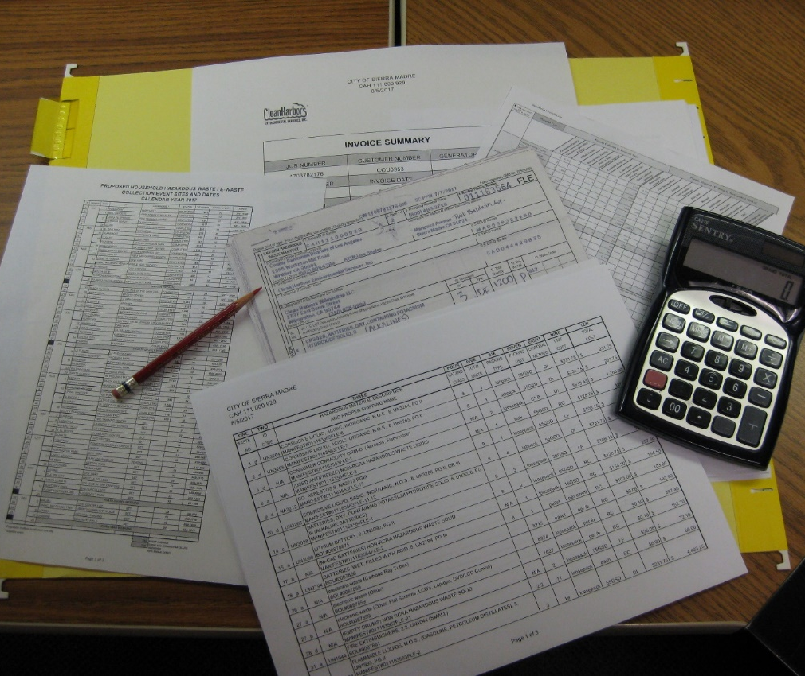
Post-event Reporting
Manifest Waste Summary
CUPA Follow-up
DTSC Manifest Submittal
Invoice Verification
Form 303 Check

Slide 28
Households Served and Quantities Collected
39,000 households served at Temporary events
13,000 households served at the EDCO Permanent Center
3.1 M pounds collected at Temporary events
1.1 M pounds collected at the EDCO Permanent Center
*Partial year data.

Slide 29
Waste Disposition Estimates
Recycled | Incinerated, Treated, or Landfilled*
70% | 30%
Paint | Solvents and thinners
Batteries (lead acid, rechargeable) | Pesticides and poisons
Mercury | Medicines and Sharps
Used motor oil | Aerosols
Electronic waste | Batteries (alkaline)
Fluorescent lamps | Asbestos
Antifreeze
*Landfilling represents an average 6% of all disposal methods.

Slide 30
Annual Cost (millions)
4.0 M for Temporary events
750,000 for the EDCO Permanent Center
*Partial year data.

Slide 31
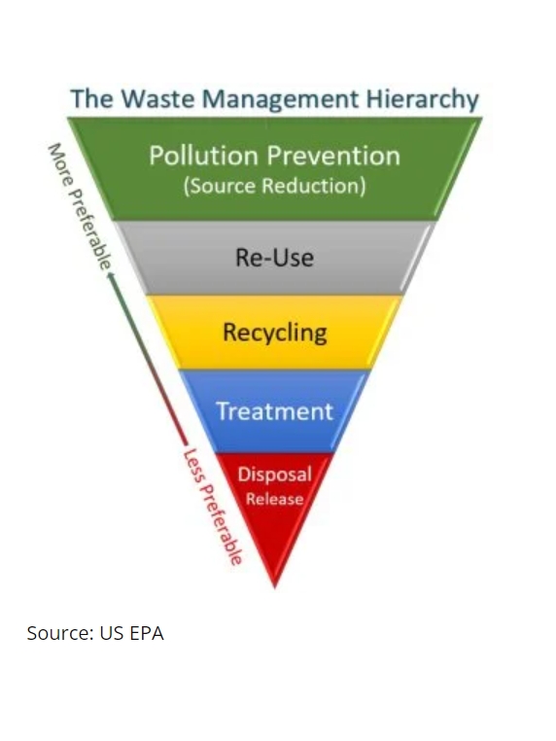
Additional Thoughts…
Challenges
    Labor Costs
    Embedded Lithium-ion Batteries
    Commingled Wastes/MSW
    Overwhelming Participation
    Small Operating Area
Considerations
    Education
    EPR
    Consumer Rebate Programs
    Additional Permanent Centers

Slide 32
Contact Information
Lisa Scales
HHW Project Engineer
lscales@lacsd.org
562.908.4288 ext. 2489

Slide 33
Infrastructure LA
Sustainable Waste and Recycling Management
  Household Hazardous and Electronic Waste
  Chris Sheppard
  Principal Engineer
  LA County Public Works
  CSheppard@pw.lacounty.gov
  Lisa Scales
  Project Engineer
  LA County Sanitation Districts
  LScales@lacsd.org
  John Park
  Senior Environmental Engineer
  LA City Sanitation
  John.Park@lacity.org
  Yasi Lozano
  Environmental Engineer
  LA City Sanitation
  Yasi.Lozano@lacity.org

Slide 34
City of Los Angeles, Department of Public Works LA Sanitation & Environment
Solid Resources Citywide Recycling Division, Residential Special Materials Program
November 9, 2023
Presented by: John Park, Senior Environmental Engineer
Yasi Lozano, Environmental Engineer

Slide 35
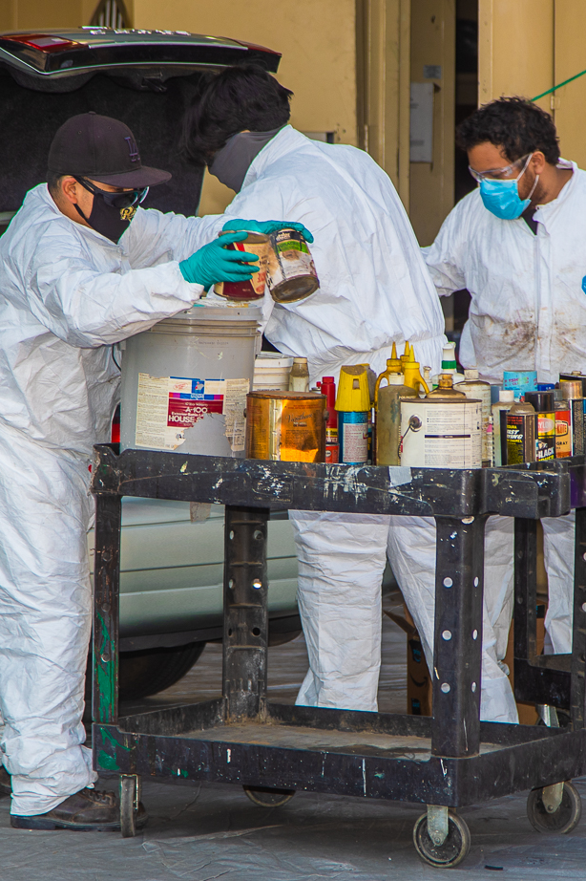
Residential Special Materials Program
Used Oil Recycling and Mobile Collection Program
Electronic Waste Recycling Program
Remote Battery & Sharps Collection
S.A.F.E. Centers
  Permanent collection sites for residents to drop off their household hazardous waste (HHW) and electronic waste (e-waste)

Slide 36
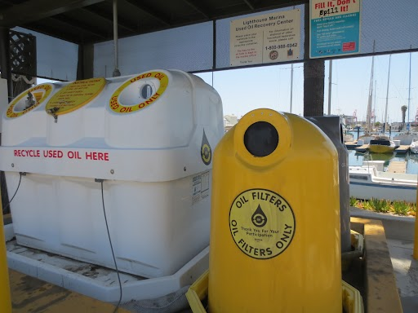
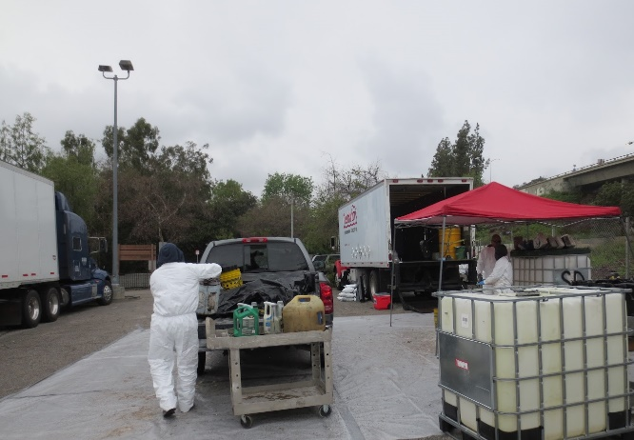
Used Oil Recycling Program
Used Oil Payment Program Grant Recipient
Department of Resources Recovery and Recycling (CalRecycle)
Marina Used Oil Recovery Centers
  14 sheltered used oil tanks and drums in San Pedro and Wilmington
  Servicing boaters and nearby residents
  Collects used motor oil, used oil filters, and oily rags & debris
Certified Collection Centers (CCCs)
  Auto part stores, lube stations, car dealerships certified to collect and recycle used motor oil from residents or generated as a business
  190 CCCs in City of Los Angeles
Mobile Collection Events
  Temporary collection events held in accessible parking lots
  Communities outside of SAFE centers’ effective radius

Slide 37
Annual Used Oil Collection
Used Oil Collected at SAFE Centers, Marinas and Mobile Events
Used Oil Collected by Certified Collection Centers (CCCs)
Year | Total Used Oil (lbs)
2020 | 1,232,786
2021 | 1,429,169
2022 | 1,610,085

Slide 38
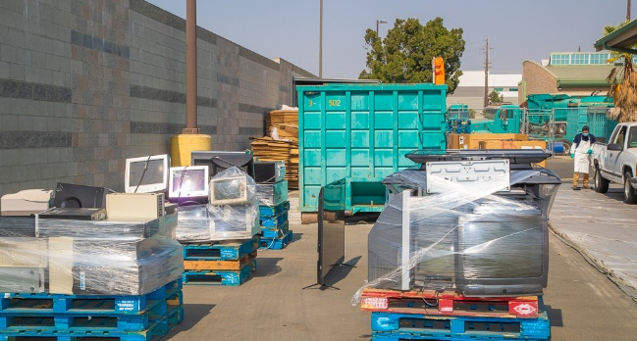
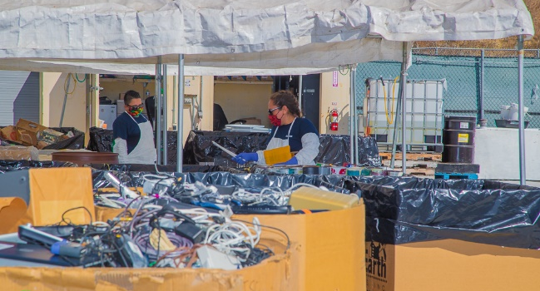
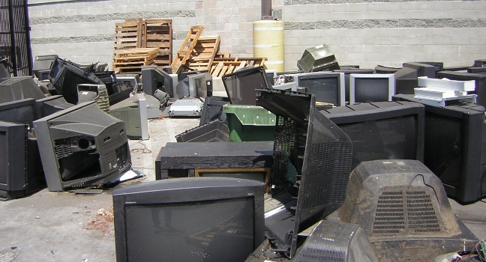
Electronic Waste Recycling Program
Approved Collector with the CalRecycle Covered Electronic Waste Program
E-Waste is collected citywide through many methods of collection
  7 S.A.F.E. Centers
  Mobile Collection Events
  Bulky Item Pick-up (curbside collection)
    6 LASAN Solid Resources Yards
  General Services Department Salvage
    Office equipment, miscellaneous e-waste
Revenue generating for RSM Program
E-Waste Collected:
  TVs, computers, tablets, printers, cell phones, radios, cables and wires, and much more

Slide 39
Annual E-Waste Collected
E-Waste Collected at SAFE Centers, LASAN Yards and Mobile Events
Total E-Waste Collected
Fiscal Year | E-Waste (lbs)
18-19 | 4,852,821
19-20 | 3,510,859
20-21 | 4,878,335
21-22 | 4,084,875
22-23 | 3,470,903

Slide 40
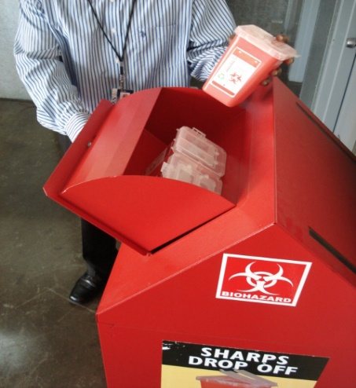

Remote Sharps & Batteries Collection
Sharps Collection Program:
30 drop-off locations throughout City of Los Angeles
  Includes Senior Citizen Centers, Council District Field Offices, City Hall and other City facilities
Aims to safely dispose of hypodermic needles, syringes, lancets, Epi-pens
Battery Bucket Collection Program:
149 sites in City of Los Angeles
  Located in Libraries, Police and Fire Stations, and other City facilities
Convenient for residents and City employees
Household AA, AAA, D-Cell, C-Cell, rechargeable and button batteries

Slide 41

S.A.F.E. Collection Centers
Solvents – Automotive – Flammables - Electronics
7 S.A.F.E. Centers – Permanent Household Hazardous Waste (HHW) collection centers
  Drive-thru, drop-off service free to City and County of Los Angeles Residents
  Open on Saturdays & Sundays, 9am – 3pm
  MOU with UCLA to operate a S.A.F.E. Center on campus with EH&S Department
    Thursdays, Fridays & Saturdays, 8am – 2pm
Over 130,000 participants annually, collecting over 8M pounds HHW and E-Waste
First S.A.F.E. Center at Hyperion Water Reclamation Plant opened in 2002
Randall S.A.F.E. Center

Slide 42

City of Los Angeles Demographics
~ 3.9M Residents
~ 468.7 square miles
8,312 residents per square mile, 1.5M housing units
15 Council Districts
S.A.F.E. Center | Serving Communities
Nicole Bernson (Balboa) | West Valley
Randall Street | East Valley
LA-Glendale | Central LA
UCLA | West LA
Washington Blvd. | East LA
Hyperion | Playa Del Rey, Beach Cities
Gaffey Street | Harbor Area
Source: https://planning.lacity.org/resources/demographics

Slide 43

S.A.F.E. Collection Centers (cont’d)
Solvents – Automotive – Flammables - Electronics
Very Small Quantity Generator (VSQG) Program
  Economical solution for small businesses that generate small quantities of hazardous waste
  appointment-based, fee-based program
  Small businesses work directly with hazardous waste contractor
Reuse, Recycle and Reduce Program
  Collected at SAFE Centers that meet program criteria.
  Includes new/unused, unopened, good condition items.
  LASAN Giveaway Events

Slide 44
Annual S.A.F.E. Center Participation
Total Number of Participants per SAFE Center
Total Participants
Fiscal Year | Participants
18-19 | 134,242
19-20 | 99,720
20-21 | 162,428
21-22 | 148,322
22-23 | 135,335

Slide 45
S.A.F.E. Center Participation
Number of Participants: City and County
Participation Over the Last Five Years

Slide 46
Annual Waste Collection at S.A.F.E. Centers
Volume of HHW & E-Waste Collected Per SAFE Center (lbs)
Total Volume of Waste Collected
Fiscal Year | Total HHW (lbs) | Total E-Waste (lbs) | Total Annual Waste Collection (lbs)
18-19 | 5,361,780 | 2,981,797 | 8,343,577
19-20 | 4,033,810 | 2,277,788 | 6,311,598
20-21 | 6,832,173 | 3,738,093 | 10,570,266
21-22 | 5,641,686 | 3,211,493 | 8,853,179
22-23 | 4,614,401 | 2,751,444 | 7,365,845

Slide 47
Waste Management Costs
Expenditure: Last Five Fiscal Years
Fiscal Year | Cost
FY 18-19 | $ 4,721,302
FY 19-20 | $ 3,692,805
FY 20-21 | $ 5,933,023
FY 21-22 | $ 5,467,160
FY 22-23 | $ 5,247,764

Slide 48


Awards
Call2Recycle Leader in Sustainability Award for Battery Recycling
Over 30,000 lbs of rechargeable batteries
South Bay’s Best, Annual Reader’s Choice Awards
Voted Best Recycling Center in the South Bay Area

Slide 49
Challenges
Rise in Program Costs
(waste management, labor, facility maintenance)
Big City, Big Responsibilities
Public Awareness and Education

Slide 50



Program Goals
HHW Program Growth
More Partnerships
Improvements in Customer Service
LASAN actively searching for suitable locations to build more SAFE centers
Utilize more green, sustainable waste management outlets
Collaboration with LA County DPW and neighboring cities
Participate in available Stewardship Programs
Accept more waste streams
More collection opportunities in underserved communities
LASAN Webpage and Notification

Slide 51
LASAN HHW Program Management
John Park, Senior Environmental Engineer
John.Park@lacity.org
Yasi Lozano, Environmental Engineer Yasi.Lozano@lacity.org
www.lacitysan.org/safecenters

Slide 52
Infrastructure LA
Sustainable Waste and Recycling Management
  Household Hazardous and Electronic Waste
  Chris Sheppard
  Principal Engineer
  LA County Public Works
  CSheppard@pw.lacounty.gov
  Lisa Scales
  Project Engineer
  LA County Sanitation Districts
  LScales@lacsd.org
  John Park
  Senior Environmental Engineer
  LA City Sanitation
  John.Park@lacity.org
  Yasi Lozano
  Environmental Engineer
  LA City Sanitation
  Yasi.Lozano@lacity.org

Slide 53
Infrastructure LA
Sustainable Waste and Recycling Management
Thank you for joining today’s call!
For more information on Infrastructure LA and to sign up for email updates about future calls visit the website at: www.infrastructurela.org
Email: ILASWARM@pw.lacounty.gov

